Slide 1

Knowledge Graph Creation from Text with LLMs
Ar Pazari and Didarbek Baidaliyev
Technische Universität München
TUM School of Computation, Information and Technology

Slide 2

Knowledge Graph Creation from Text with LLMs
Overview :
Recap
Technical Background
LLM’s
HuggingFace Transformers
Current progress
Data extraction and Preparation
Setup and Infrastructure
Initial Prompt Engineering Results
Next steps

Slide 3
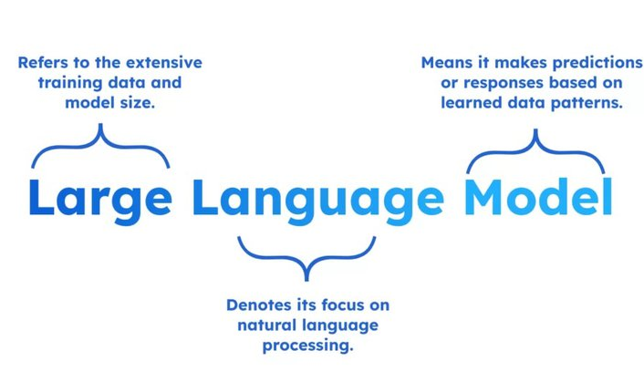
Recap
Large Language Model
What are LLM’s and why are they important for us ?

Slide 4
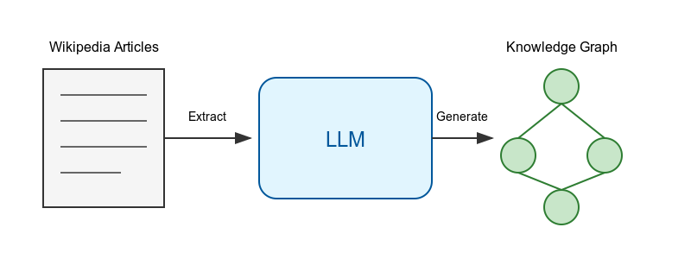
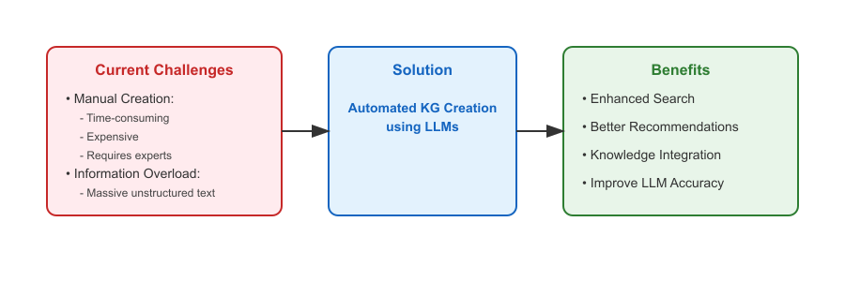
Recap
Problem Statemenet : Transform unstructured Wikipedia articles into structured knowledge graphs using LLM’s.
Key Components :
Input
Process
Output
Main Challenges :
Accuracy of Triple Extraction
Prompt Design for LLM’s
Ontology Alignment

Slide 5
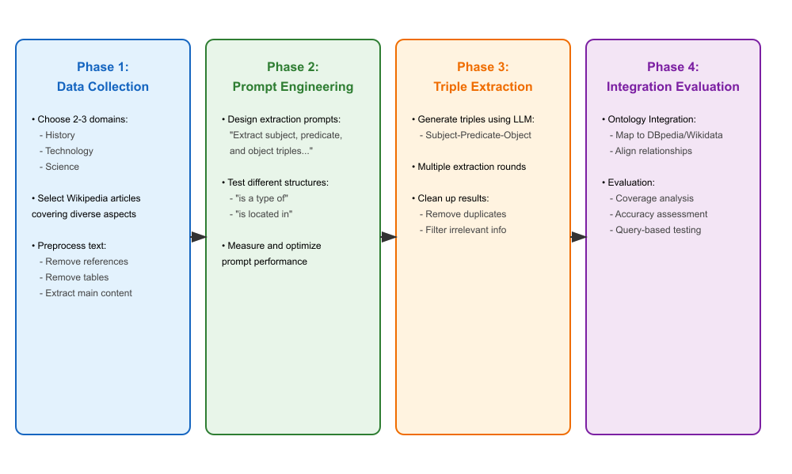
Recap
Our Roadmap :

Slide 6
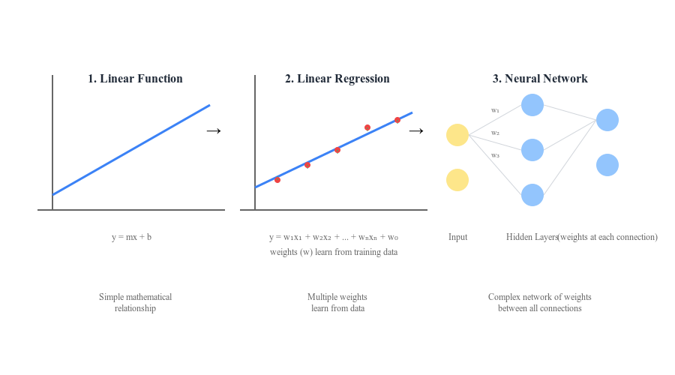
Technical Background
How do neural networks work ?

Slide 7
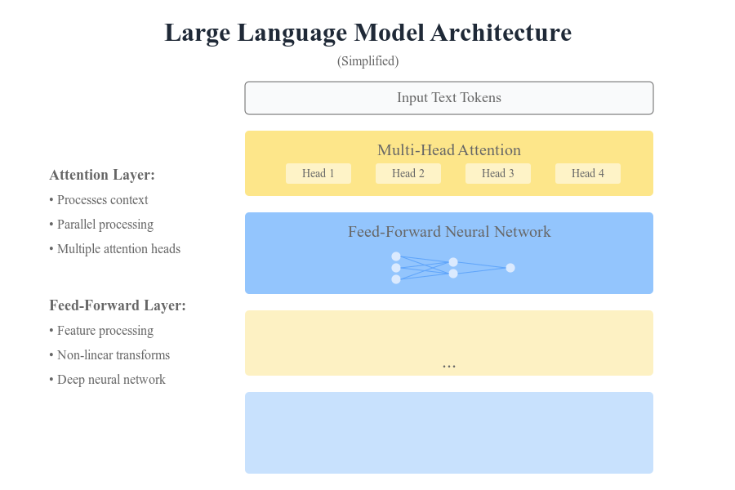
Technical Background
What about LLM ?

Slide 8
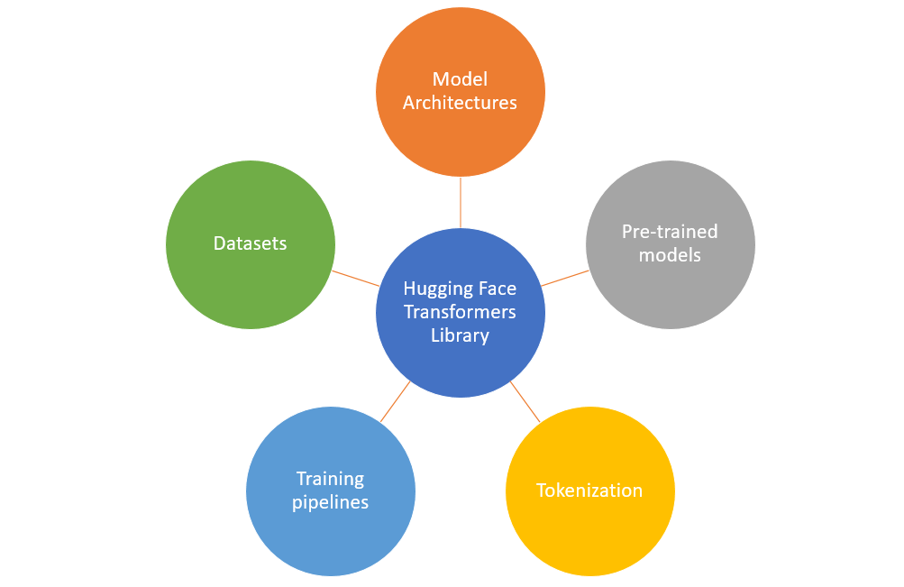
Technical Background
Hugging Face Transformers Libray

Slide 9


Data extraction
First Step : Extraction
Making a request to the Wikipedia pages
Extracting the data
Decomposing tables and removing references
Dividing the text in chunks of a fix length
Creating for each chunk a text

Slide 10
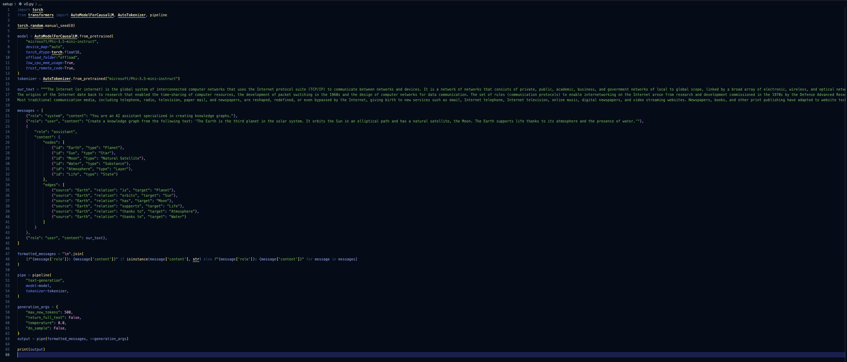
Current Progress
Must be generic
Must be Files with the Data …
Setup and infrastructure – v0

Slide 11
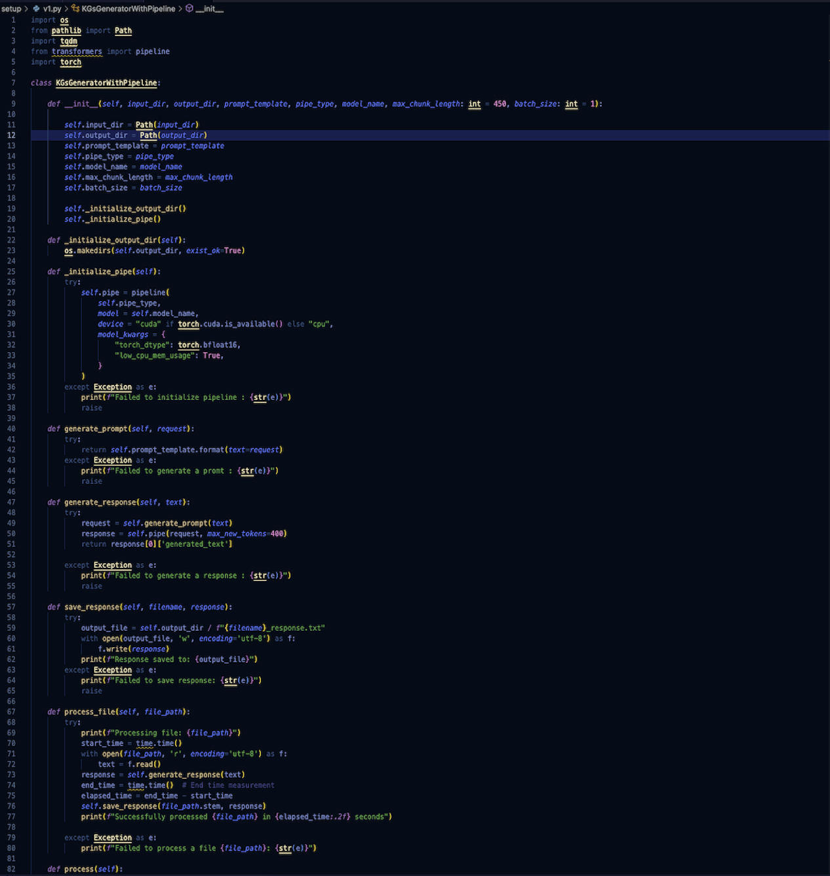
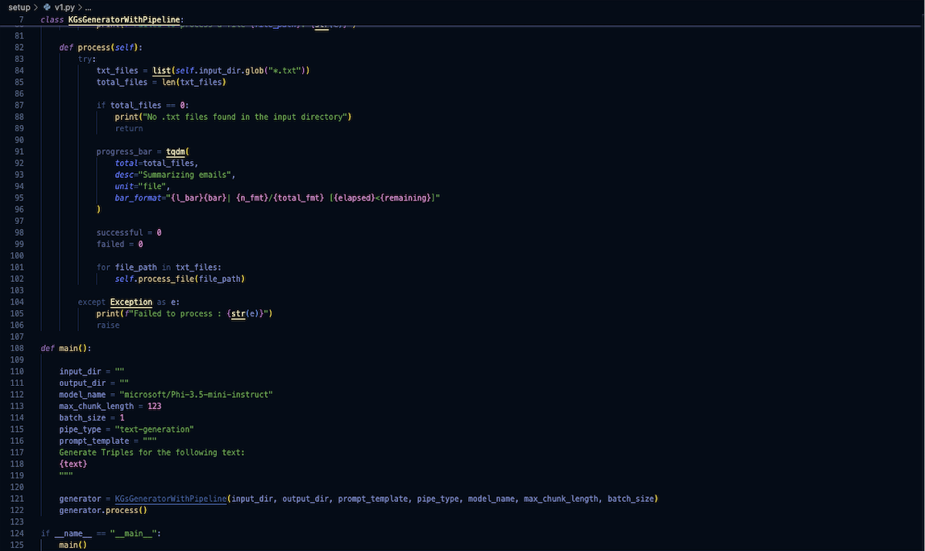
Current Progress
(Zoom the code ☺ )
Setup and Infrastructure – v0.1
System Prompting?
1
2

Slide 12
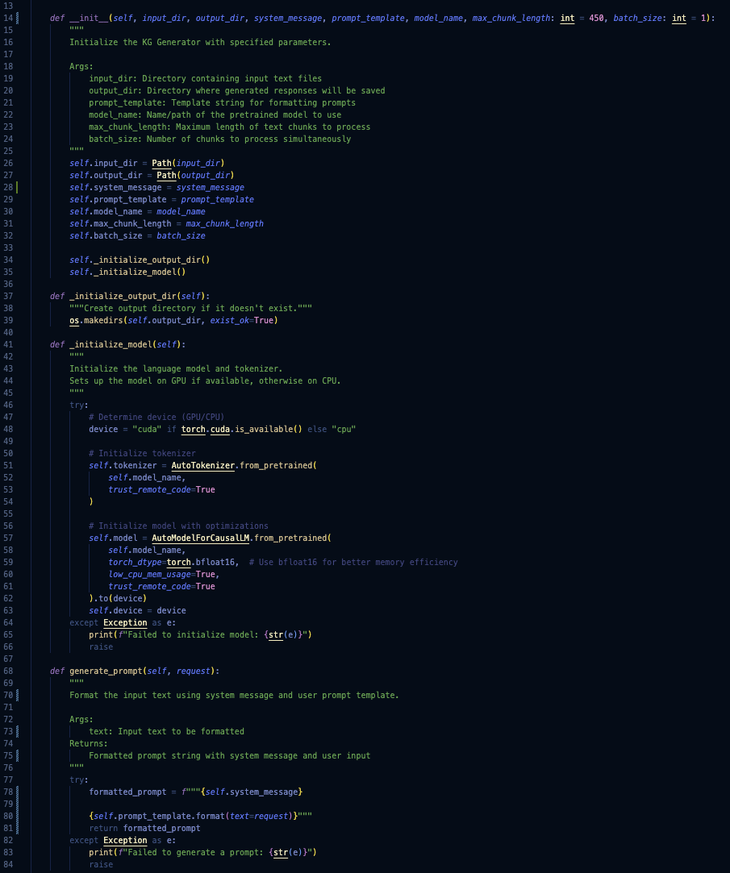
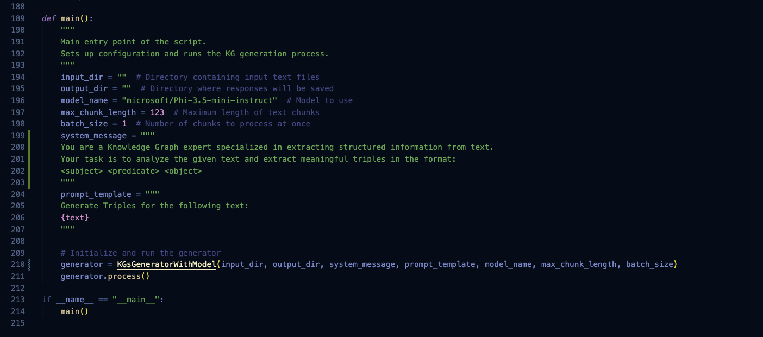
Current Progress
(Zoom the code ☺ )
Setup and Infrastructure – v1
1
2

Slide 13
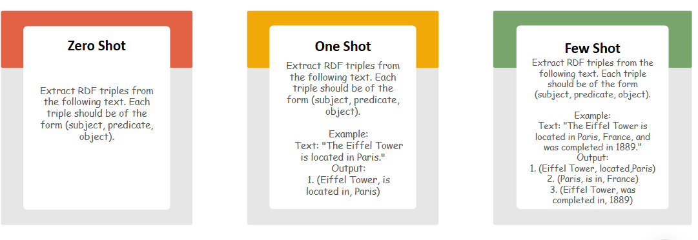
Prompt Design

Slide 14
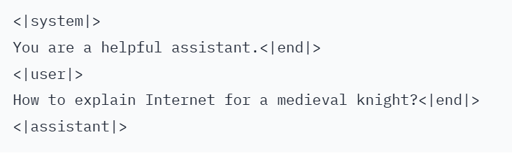
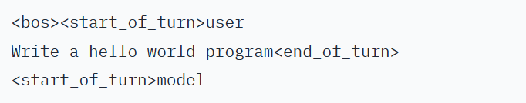
Promt Structure
Maximizing the quality of our results.
The context is better defined.
The task is clearer.
The structure is more correct.

Slide 15
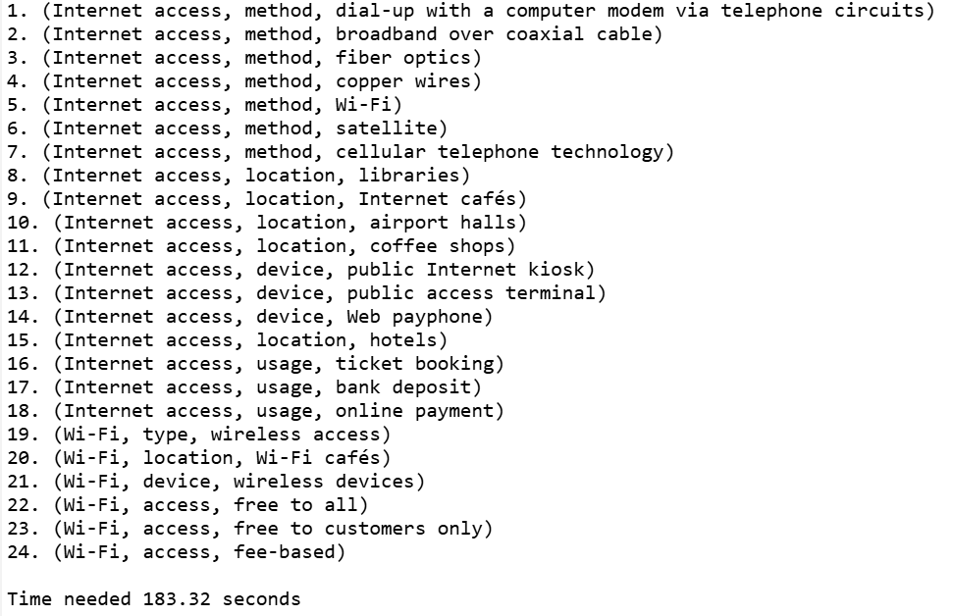
Results : Zero Shot

Slide 16
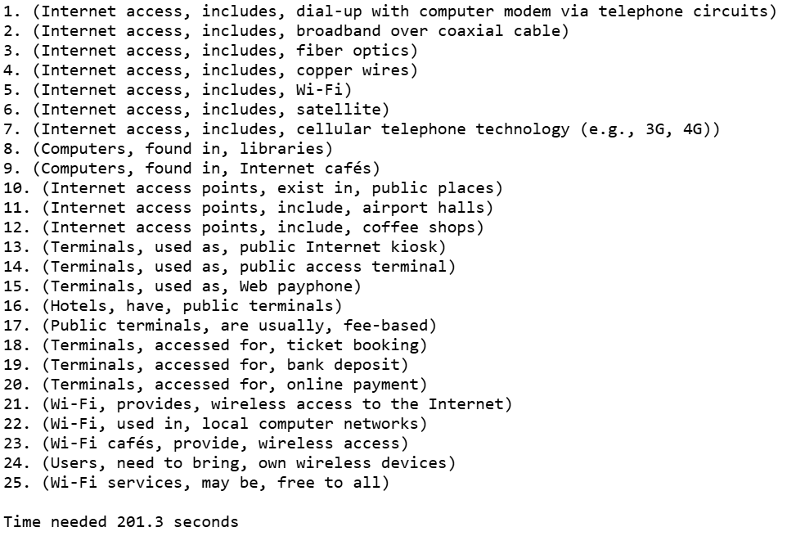
Results : One Shot

Slide 17
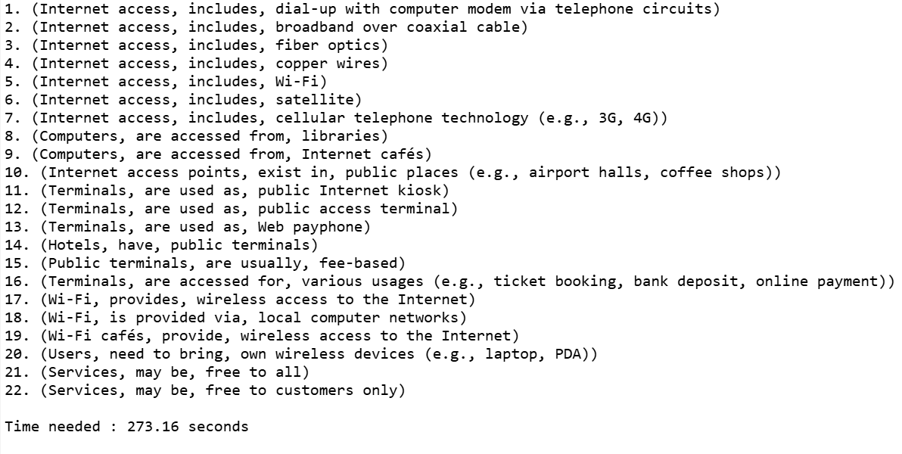
Results : Few Shots

Slide 18
Problems while Evaluating
Sample :
The Internet standards describe a framework known as the Internet protocol suite (also called TCP/IP)
Two kind of problems we might face :
Output is not of the same length as expected
Partially different triples
Output 1:
(Internet standard, described as, Internet protocol suite)
Output 2:
(Internet standard, described as, Internet protocol (TCP)

Slide 19
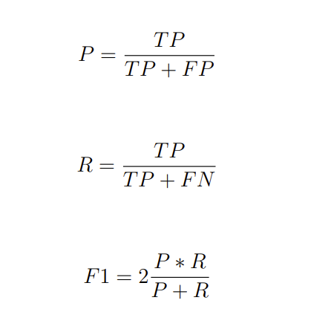

Metrics
Evaluation of results based on these metrics
P → Precision
R → Recall
F1 → Harmonic mean of P and R

Slide 20
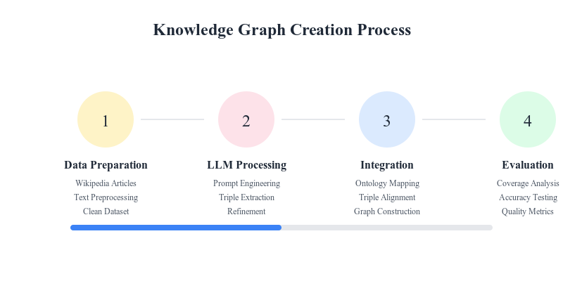
Next Steps
New Roadmap : )

Slide 21

Thank you for your attention!
Any Questions ?

Slide 22
Sources for images
Slide number 3 - Link
Slide number 4 - 7, 20 - Generated using a LLM
Slide number 10 - 12 - Created by Didarbek Baidaliyev
Slide number 8 – Link
Slide number 21 - Link

Slide 23
Sources for images
Slide number 2 - Link
Slide number 9 - First picture, second picture
Slide number 13 - Generated by LLMs
Slide number 14 - First picture, second picture
Slide number 19 - Taken from this paper

